Slide 1

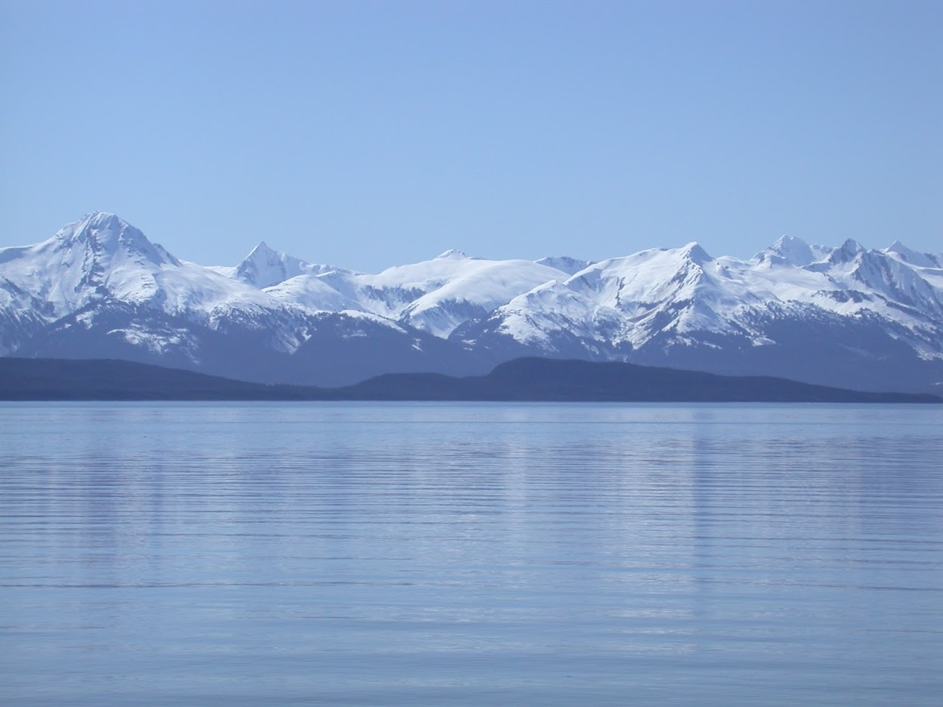


GOA Skate Stock Complex Update
Lee Cronin-Fine
November, 2023, Presentation to the GOA Groundfish Plan Team
Notes:
Replace picture in circle with speaker picture

Slide 2
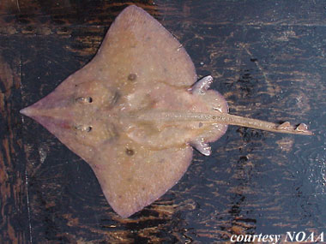
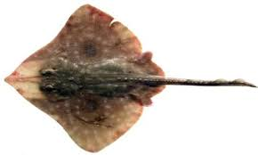
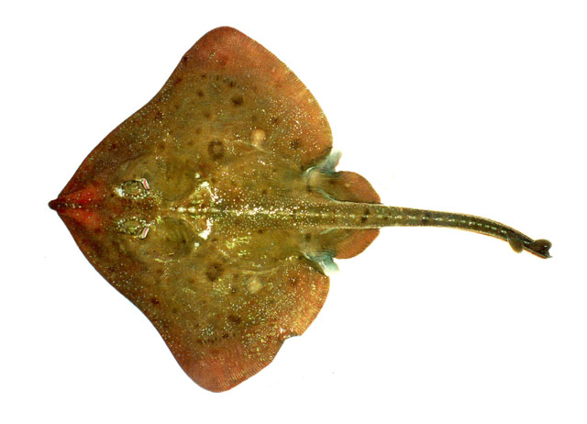
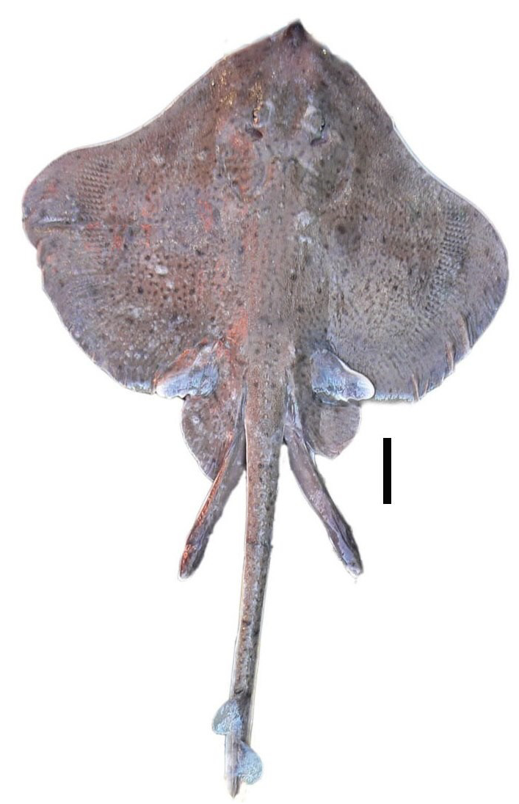
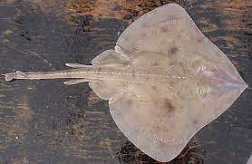
Assessment Groups
Longnose Skate
Big Skate
Other Skates

Slide 3
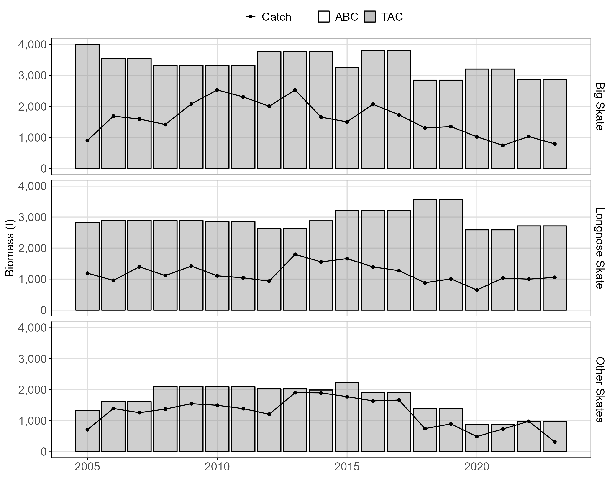
Stock Complex Overview
Tier 5
Group | OFL (t) | ABC (t) | Catch (t)*
Big | 3,822 | 2,867 | 792
Longnose | 3,616 | 2,712 | 1,055
Other | 1,311 | 984 | 316
*As of October 16th, 2023

Slide 4
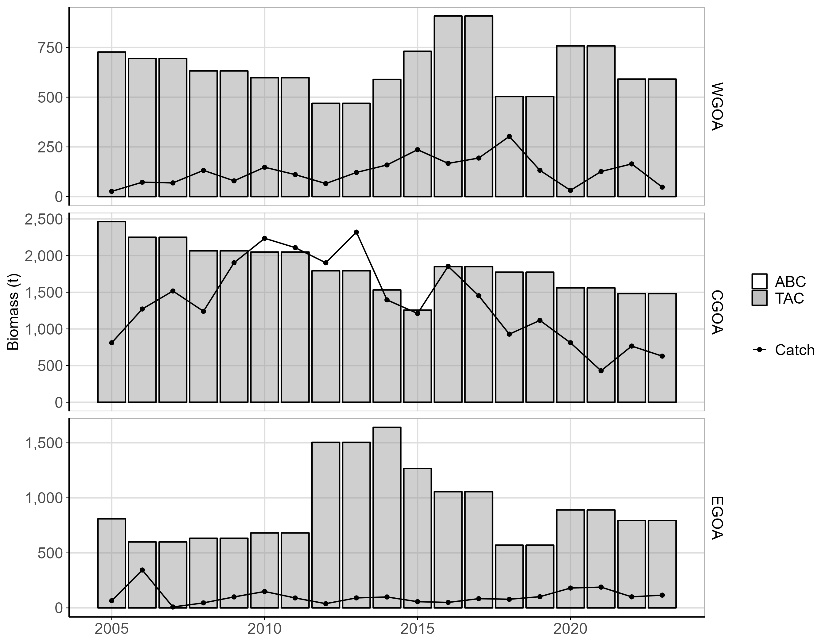
Big Skate Area Overview
Tier 5
Group | ABC (t) | TAC (t) | Catch (t)*
WGOA | 591 | 591 | 47
CGOA | 1,482 | 1,482 | 629
EGOA | 794 | 794 | 116
*As of October 16th, 2023

Slide 5
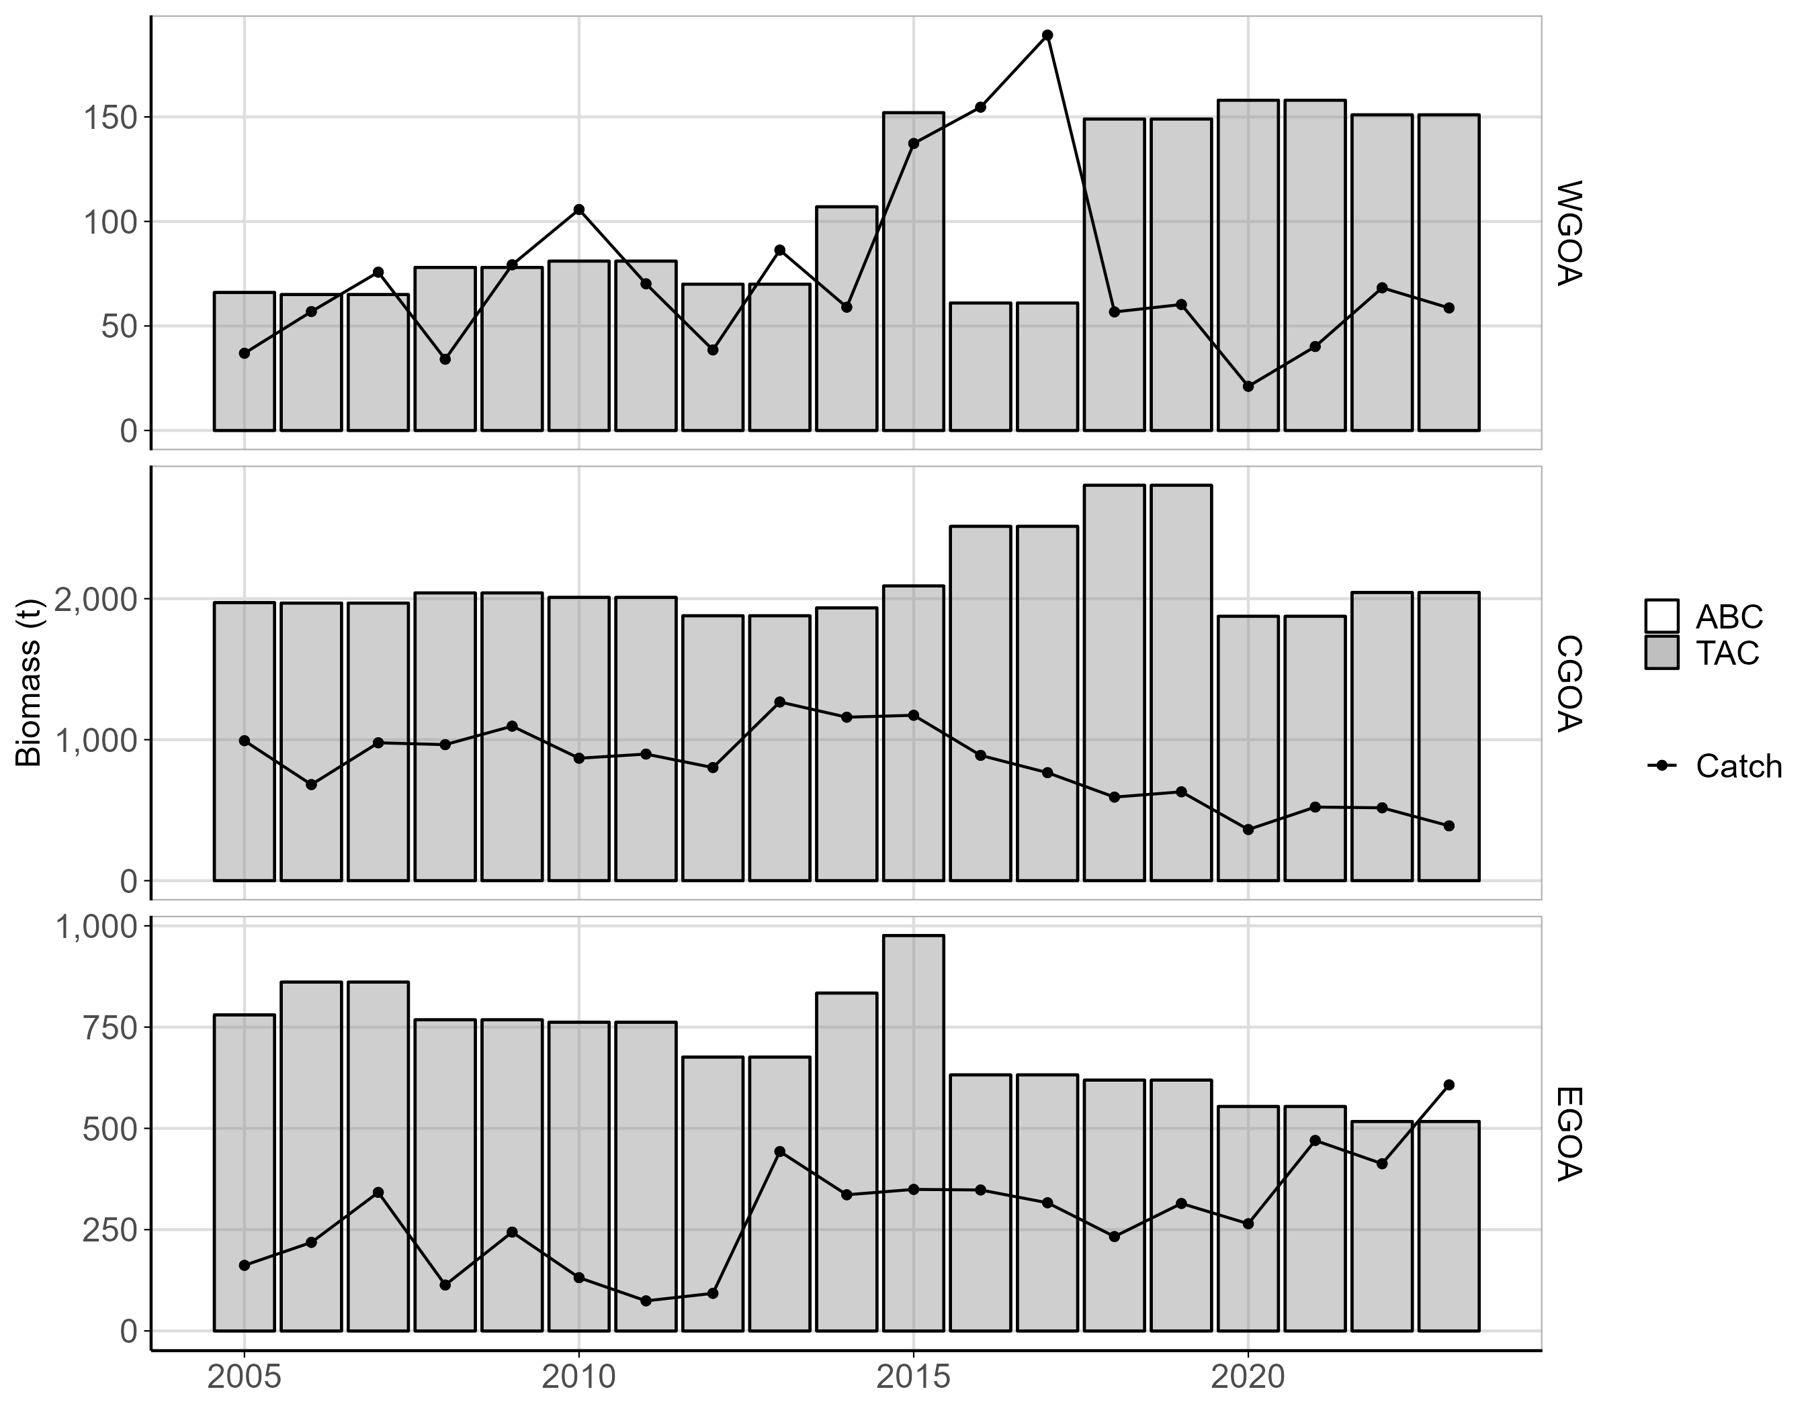
Longnose Skate Area Overview
Tier 5
Group | ABC (t) | TAC (t) | Catch (t)*
WGOA | 151 | 151 | 792
CGOA | 2,044 | 2,044 | 389
EGOA | 517 | 517 | 607
*As of October 16th, 2023

Slide 6
<Slide Title>
<Main bullet>
<Text>
<Text>
<Main bullet>
<Text>
<Text>
<Main bullet>
<Text>

Slide 7
<Slide Title>

Slide 8
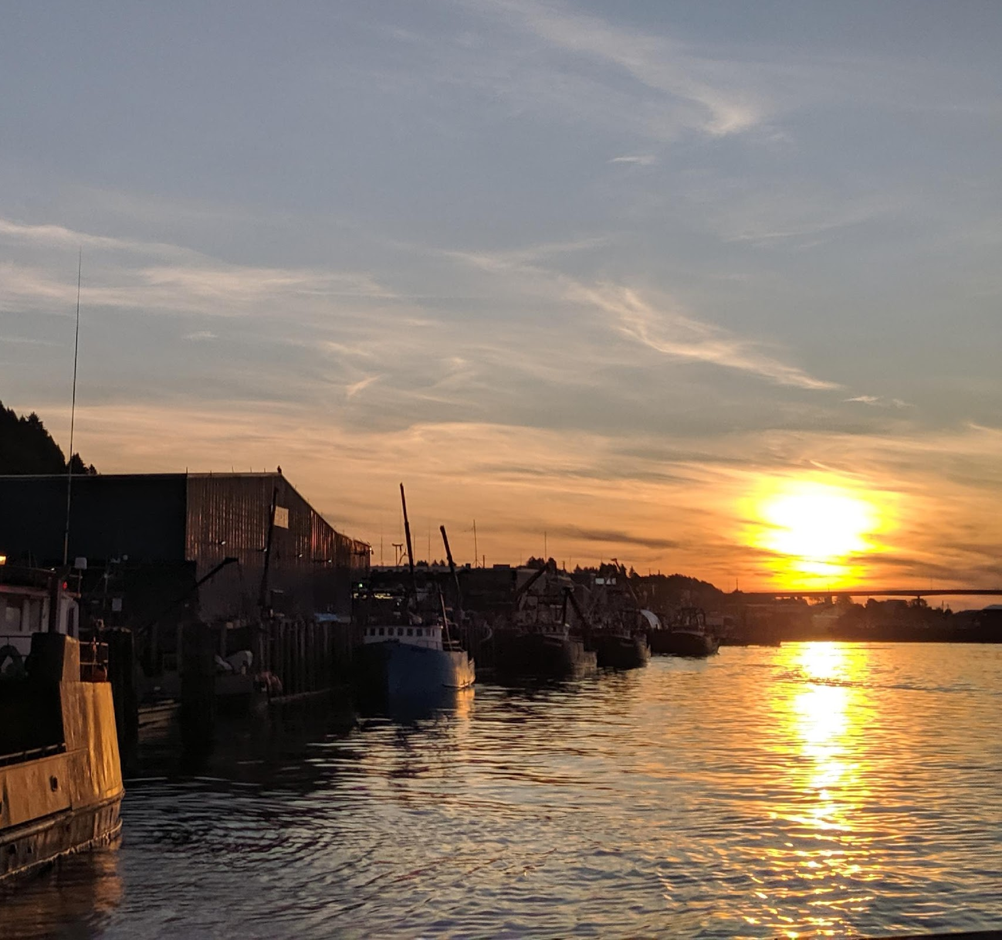
<Text>
<Contacts>
<List of Emails>
Notes:
Replace center picture as needed

